Slide 1
The Cyber Detective's Toolkit: Stories of AI Fighting Digital Crime
Chapter 12 - The Human Factor: Combining AI with Human Expertise

Slide 2
Case Study Introduction: CrowdStrike's Hybrid Intelligence Model
01
02
AI Detection Capabilities
Human Analyst Role
The CrowdStrike Falcon platform's AI processed telemetry from millions of endpoints and flagged unusual process executions, lateral movements, and credential harvesting activities across fourteen organizations. It efficiently correlated billions of events to surface high-confidence alerts, revealing a sophisticated and coordinated attack even when patterns had no prior signature.
Human analysts brought critical judgment and contextual understanding, linking alerts to a known nation-state threat group and deciding on precise containment actions. They interpreted anomalies with organizational knowledge, made strategic decisions such as waking CISOs, and applied intuition that the AI could not replicate.
Harnessing AI and Human Expertise: Advancing Cybersecurity in an Evolving Digital Landscape

Slide 3
CrowdStrike Attack Overview: Coordinated Nation-State Intrusion
01
02
03
Attack Scope
Human-AI Collaboration
Incident Outcome
Simultaneous intrusion attempts targeted fourteen organizations across three continents within the defense industrial base. The AI system detected unusual process executions, lateral movement, and credential harvesting behaviors with no known signature, signaling a sophisticated threat actor.
While the AI flagged high-confidence alerts and correlated vast telemetry data, human analysts applied contextual understanding, intuition, and memory to connect the attacks to a known adversary group, deciding on critical containment actions and escalation procedures.
Thirteen of the fourteen intrusions were contained with no data exfiltration, while one organization had a limited breach of approximately 2,000 files. This rapid coordination between AI detection and human judgment mitigated a coordinated nation-state campaign within five hours.
Harnessing AI and Human Expertise: Advancing Cybersecurity in an Evolving Digital Landscape

Slide 4
Why Fully Automated Security Doesn't Work: Overview
False Positives
Context Blindness
Adversarial Attacks
Novel Threats
Accountability Gap
Automated AI systems frequently generate incorrect alerts, mistaking legitimate activity for threats. High false positive rates cause operational disruptions, overwhelm security teams, and foster alert fatigue, which undermines trust and allows real threats to be missed.
AI lacks the ability to understand nuanced organizational context, such as business processes, user roles, and unusual but legitimate activities. Without this understanding, automated systems misinterpret behaviors, causing erroneous responses and missed legitimate explanations.
Attackers exploit vulnerabilities in machine learning by subtly modifying malicious inputs or poisoning training data to fool AI systems. Without human oversight, these manipulations remain undetected, making fully automated defenses susceptible to evasion and compromise.
AI relies on historical data and struggles to detect genuinely new attack techniques. Human analysts apply intuition and experience to identify and respond to novel threats that evade automated pattern recognition.
When AI operates autonomously, responsibility for errors becomes unclear. Fully automated systems create ethical and legal challenges since AI cannot be held accountable, making human oversight essential for managing risks and ensuring responsible security actions.
Harnessing AI and Human Expertise: Advancing Cybersecurity in an Evolving Digital Landscape

Slide 5
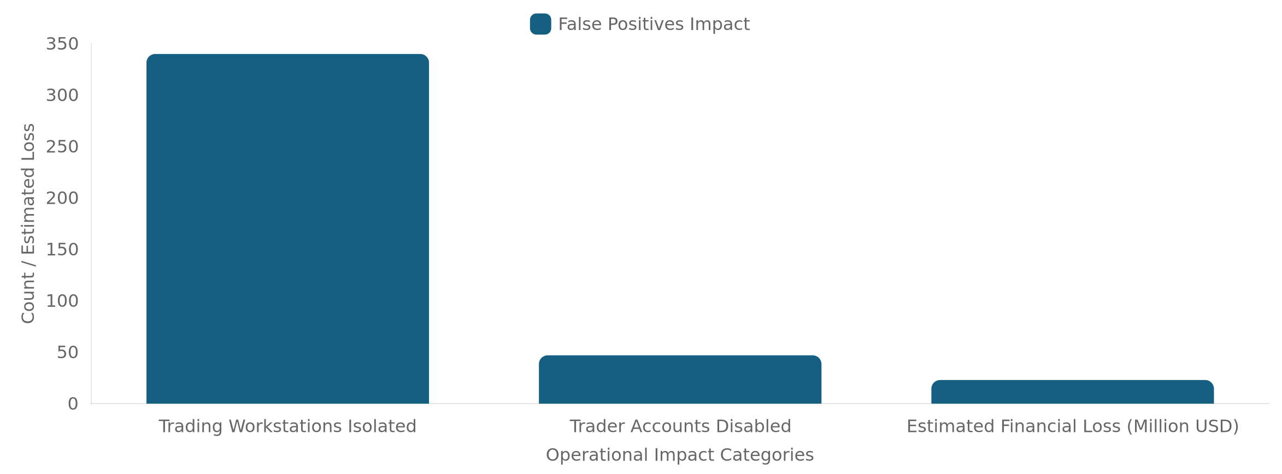
The False Positive Catastrophe in Fully Automated AI Security
Harnessing AI and Human Expertise: Advancing Cybersecurity in an Evolving Digital Landscape

Slide 6
The Context Blindness Problem
Lack of Contextual Awareness
AI systems excel at detecting anomalies by comparing behavior against learned baselines but lack the ability to understand situational context. This deficiency causes them to flag legitimate but unusual activities as threats, leading to false positives and unnecessary responses. For example, an AI might detect unusual access patterns without recognizing underlying business reasons.
Human Contextual Judgment
Humans understand organizational context and can interpret why certain behaviors occur outside normal patterns. Consider a CFO working late at night downloading sensitive financial data to an approved cloud storage service. While AI flags this as suspicious, a human analyst recognizes the business need and timing, avoiding a false alarm and inappropriate lockdown.
Harnessing AI and Human Expertise: Advancing Cybersecurity in an Evolving Digital Landscape

Slide 7
Adversarial Attacks: When AI Becomes The Target
Evasion Attacks
Data Poisoning
Model Extraction
Prompt Injection
Attackers subtly modify malicious inputs such as malware code, network packets, or phishing emails to appear benign to AI classifiers while remaining functional. They add small noise patterns or minor changes to cause AI to misclassify threats as safe, evading detection.
Attackers inject corrupted samples or slowly shift training data so the AI learns malicious patterns as normal. This creates blind spots or backdoors in the AI model, allowing future attacks to bypass detection unseen by automated systems.
By repeatedly querying AI systems and analyzing responses, attackers reverse-engineer the AI model. This knowledge enables crafting attacks specifically designed to evade detection by exploiting the system's learned patterns.
For AI systems using large language models, attackers craft inputs that override intended instructions. This manipulation may cause the system to leak sensitive information or perform harmful actions, compromising AI security functions.
Harnessing AI and Human Expertise: Advancing Cybersecurity in an Evolving Digital Landscape

Slide 8
The Novel Threat Problem
01
02
AI's Limitation with Novel Attacks
Human Analyst Intuition and Adaptability
AI systems rely on historical data to learn patterns and detect threats. When faced with genuinely new attack techniques not seen before, AI lacks the training data to accurately classify or respond. It can flag unusual behavior as anomalous but cannot interpret or adapt effectively to unknown threats. This creates a detection blind spot during the initial emergence of novel attacks.
Human threat hunters excel in ambiguous situations where AI falls short. Analysts use intuition, drawing on experience to sense when 'something feels wrong' even without clear signatures. They hypothesize attacker motivations, improvise responses, and predict next moves based on subtle clues. This contextual understanding and creative problem-solving are essential for identifying and mitigating novel threats.
Harnessing AI and Human Expertise: Advancing Cybersecurity in an Evolving Digital Landscape

Slide 9
The Accountability Gap in Fully Automated Security
Legal and Ethical Challenges
AI systems lack moral agency and cannot be held accountable for errors they cause in security operations. When fully automated systems contribute to failures such as missed breaches or business disruptions, responsibility becomes unclear, creating an accountability gap.
Human Oversight Requirements
Organizations must design security operations with meaningful human control. Humans bear responsibility for configuring AI systems appropriately, supervising critical decisions, and providing oversight to catch AI errors or manipulation.
Regulatory Compliance
Regulations like GDPR and the EU AI Act mandate explainability, human review, and clear accountability chains for automated decisions affecting people and business functions. "The AI did it" is not an acceptable explanation for failures.
Ethical Allocation of Responsibility
Accountability should be distributed among organizations (design and deployment), analysts (application and judgment), and vendors (transparency and support). Clear processes and audit trails are essential.
Building these frameworks ensures that AI augmentation enhances security without creating legal or ethical blind spots, preserving trust and responsibility in cybersecurity operations.
Harnessing AI and Human Expertise: Advancing Cybersecurity in an Evolving Digital Landscape

Slide 10
Human-in-the-Loop Systems: Architecture and Components
AI-Powered Processing Layer
This layer ingests massive data volumes such as logs, network traffic, and endpoint telemetry. It applies machine learning to detect anomalies and classify threats by correlating events across sources and time windows. It generates prioritized alerts with confidence scores and supporting evidence to feed the human layer.
Human Decision Layer
At this critical layer, human analysts review AI-generated alerts, especially those with high impact or ambiguity. They apply contextual knowledge and business understanding to make judgment calls on responses and provide feedback that improves AI accuracy over time.
Automated Response Layer with Guardrails
This layer executes low-risk responses automatically, like blocking known-malicious IPs or quarantining malware. High-impact actions require human approval, supported by rate limiting and rollback capabilities to prevent cascade failures. This ensures safety and preserves human oversight at critical decision points.
Harnessing AI and Human Expertise: Advancing Cybersecurity in an Evolving Digital Landscape

Slide 11
Where Humans Must Stay in the Loop
High-Impact Response Decisions
External Communication
Human judgment is essential for decisions that significantly affect critical production systems, senior accounts, or business operations. This includes isolating systems, disabling accounts, and initiating incident responses that involve external parties. Such choices require weighing security risks against operational impacts and cannot be fully automated.
Decisions about notifying customers, regulators, law enforcement, or engaging third-party incident responders require human discretion. Effective communication balances transparency, legal considerations, and business relationships, aspects that AI cannot fully manage on its own.
Ambiguous Classifications
Strategic Response Choices
Alerts with moderate confidence or unusual patterns that do not clearly match known attack signatures demand human analysis. Humans apply organizational context and experience to discern whether an alert indicates a true threat or legitimate unusual activity, reducing false positives and missed detections.
Humans decide whether to immediately contain threats or continue monitoring for intelligence, allocate resources across simultaneous incidents, and balance security response with business continuity. These strategic judgments rely on intuition, experience, and understanding of organizational priorities.
Harnessing AI and Human Expertise: Advancing Cybersecurity in an Evolving Digital Landscape

Slide 12
Automation Models: HITL vs Human-on-the-Loop and Fully Automated
Fully Manual
Fully Automated
Human-on-the-Loop
Human-in-the-Loop (HITL)
Humans make all security decisions without AI assistance. This approach is thorough but slow and impractical for modern data volumes. It is best suited for strategic planning and post-incident analysis where deep human insight is required.
AI operates autonomously without human involvement. It is fast and efficient for routine, well-understood, low-risk decisions such as blocking known malicious IPs. However, it is fragile, prone to false positives, and vulnerable to adversarial attacks without human oversight.
AI runs independently but humans monitor the AI's actions and can intervene if necessary. This model allows for quick responses while maintaining oversight. It works well when timely intervention is critical but decisions generally do not require constant human judgment.
Humans participate actively in critical decisions, reviewing AI-generated alerts especially in ambiguous or high-impact situations. AI supports by processing data and prioritizing alerts, but humans provide contextual understanding, judgment, and accountability. This model balances speed with careful oversight for complex security tasks.
Harnessing AI and Human Expertise: Advancing Cybersecurity in an Evolving Digital Landscape

Slide 13
The Feedback Loop: Humans Training AI
Human Analysis of Alerts
AI Model Adjustment
Human analysts carefully review AI-generated alerts, determining which are true positives and which are false positives. They also add contextual explanations that clarify why certain activities are or are not threats. This detailed assessment forms the foundation for improving AI understanding and accuracy.
Based on the high-quality feedback from analysts, the AI model updates its detection patterns, learning to distinguish benign behavior from malicious actions more accurately. This refinement reduces false positives and improves overall detection capability over time.
Feedback Integration and Improvement
Continuous Monitoring
Analysts provide ongoing feedback on AI performance, signaling missed detections or new threat indicators that the AI may not yet recognize. This ongoing dialogue ensures that both the AI and human teams evolve collaboratively, maintaining robust and adaptive security.
The adjusted AI model continues to monitor network and endpoint data, applying its improved detection parameters to new alerts. As behavior patterns evolve, the system remains adaptive and sensitive to emerging threats while minimizing noise.
Harnessing AI and Human Expertise: Advancing Cybersecurity in an Evolving Digital Landscape

Slide 14
What AI Does Better Than Humans
Scale and Speed
Pattern Recognition
Consistency and Objectivity
Baseline Behavior Learning
Memory and Recall
AI can process millions of events per second, analyzing vast volumes of data beyond human capability. It operates continuously without fatigue, handling tasks tirelessly around the clock to detect threats in real time.
AI excels at detecting subtle statistical anomalies and patterns across thousands of variables simultaneously, recognizing connections spanning extensive time periods that humans cannot perceive.
AI applies uniform criteria to every alert without influence from bias, fatigue, or distraction, ensuring consistent and objective analysis without tunnel vision or anchoring errors.
AI establishes behavioral baselines for users, systems, and applications, tracking normal activity to detect deviations even when such deviations appear subtle or are otherwise unremarkable.
AI possesses perfect recall, maintaining detailed memory of historical events and telemetry, enabling rapid correlation across billions of records that human memory cannot match.
Harnessing AI and Human Expertise: Advancing Cybersecurity in an Evolving Digital Landscape

Slide 15
What Humans Do Better Than AI
Contextual Understanding
Judgment Under Uncertainty
Humans naturally grasp nuanced organizational details, business processes, and social dynamics that AI models cannot fully capture. This understanding explains why certain actions happen and differentiates between technically suspicious and genuinely threatening behavior in cybersecurity operations.
Humans are skilled at making decisions when evidence is incomplete or contradictory. They weigh multiple factors such as security risk, business impact, and customer relations, and take accountability for their decisions and consequences.
Creative Problem Solving
Communication and Coordination
Humans excel at improvising responses when predefined AI playbooks do not apply. Analysts think like attackers, hypothesizing next moves and devising novel detection and defense strategies beyond AI’s programmed capabilities.
Humans communicate findings effectively to executives, boards, and regulators. They coordinate responses across diverse teams with different priorities and maintain relationships with external partners, law enforcement, and industry groups.
Intuition and Experience
Contextual Integration
Experienced analysts develop gut feelings and can recognize subtle patterns from past incidents that AI cannot formally document. This intuition helps sense when an investigation is going off track or uncovering hidden threats.
Humans incorporate external events and organizational changes into their analysis, recognizing when anomalies have legitimate explanations and when they require action. This reduces false positives and prioritizes truly critical alerts.
Harnessing AI and Human Expertise: Advancing Cybersecurity in an Evolving Digital Landscape

Slide 16
The Augmented Analyst Workflow: Traditional vs AI-Augmented
Traditional Analyst Workflow
AI-Augmented Analyst Workflow
Analysts receive a high volume of alerts overnight and spend hours triaging each one manually. They investigate a small fraction deeply while many alerts are ignored or reviewed cursory. This leads to missed subtle patterns, exhaustion, and the risk of overlooked threats due to volume and fatigue.
AI processes and triages alerts automatically, enriching them with context and correlating related events into prioritized incidents. Analysts focus their efforts on critical threats identified by AI, reviewing and modifying AI-recommended responses. This frees analysts to work smarter and address important threats effectively.
Harnessing AI and Human Expertise: Advancing Cybersecurity in an Evolving Digital Landscape

Slide 17
Real-World AI Augmentation Tools
01
02
AI-Powered Triage Agents
Natural Language Investigation
Platforms like Dropzone AI and Google SecOps' Alert Triage Agent can autonomously investigate alerts at machine speed. These tools gather evidence, run analyses, correlate data, and determine whether alerts are true or false positives, allowing analysts to focus on reviewing clear verdicts rather than raw alerts.
Tools such as CrowdStrike's Charlotte AI enable analysts to perform investigations using natural language queries. Instead of writing complex commands, analysts ask straightforward questions and receive precise and actionable results, making the investigation process faster and more accessible.
03
04
Automated Evidence Collection
Behavioral Analytics
When AI flags an incident, modern platforms automatically assemble relevant evidence like endpoint telemetry, network connections, user activity, and threat intelligence. This automation saves analysts hours previously spent collecting data manually and delivers a comprehensive investigation package ready for review.
User and Entity Behavior Analytics (UEBA) systems learn normal behavior patterns and surface anomalies by creating risk scores for each user based on deviations. Platforms like Exabeam help analysts prioritize investigations by highlighting the most suspicious activities, reducing false positives and improving efficiency.
Harnessing AI and Human Expertise: Advancing Cybersecurity in an Evolving Digital Landscape

Slide 18
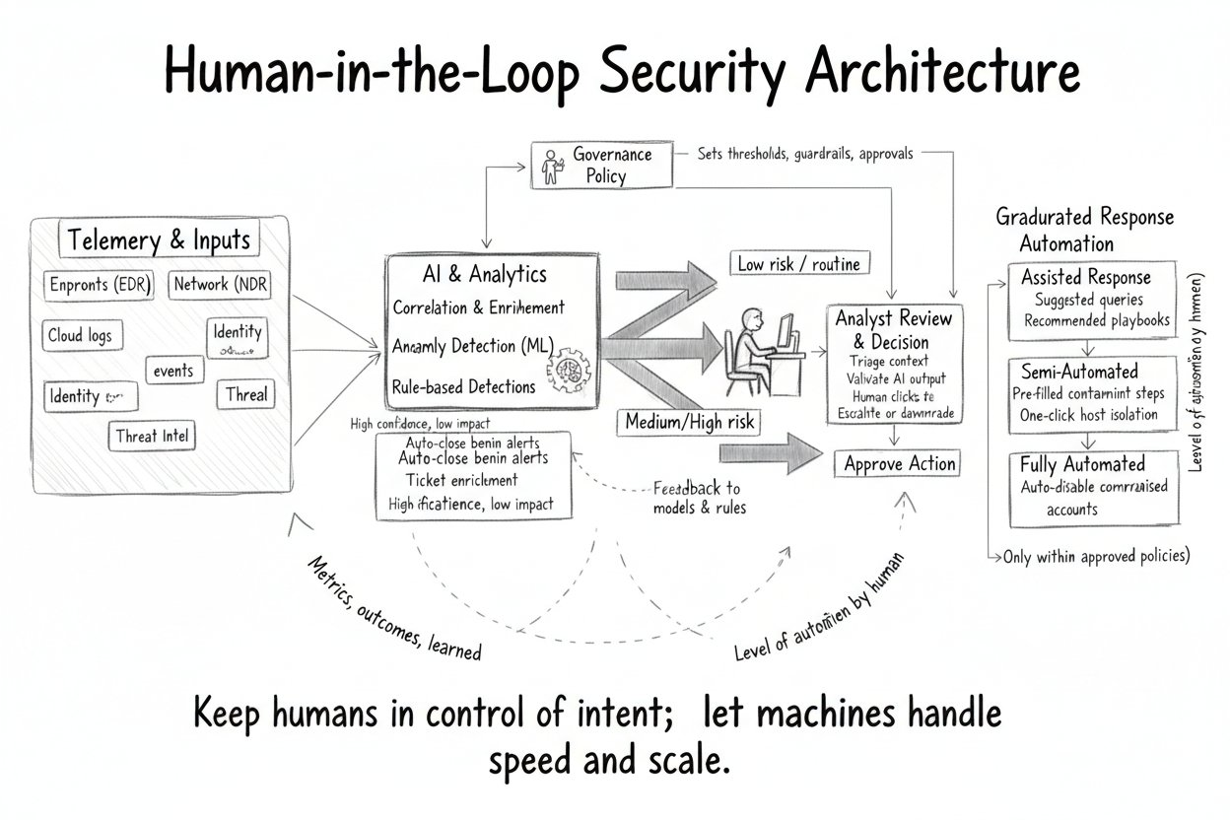
The Evolving Role of the Augmented Analyst
Shift from Triage to Investigation
AI handles the bulk of alert triage, filtering thousands of daily alerts to identify critical incidents. Analysts then focus their time on deep investigations, hunting for sophisticated threats, and strategic planning rather than routine review. This transition enables more effective use of human expertise where it matters most.
New Skills Required
Analysts need a conceptual understanding of how AI works rather than coding knowledge. They must interpret AI confidence scores accurately and recognize when AI may be uncertain or require guidance. Directing AI investigations effectively becomes essential as part of the workflow.
Enhanced Analyst Productivity
With AI augmentation, analysts can process alerts more efficiently, reducing false positives and responding faster. This allows more time for advanced tasks like threat hunting, hypothesis testing, and proactive defense, elevating the overall security posture.
Harnessing AI and Human Expertise: Advancing Cybersecurity in an Evolving Digital Landscape

Slide 19
Effective Alert Design: Fighting Fatigue Overview
Effective Alert Design: Fighting Fatigue Overview
Security analysts face an overwhelming number of alerts each day, averaging around 11,000. Most of these alerts are noise, making it challenging to find the important signals. This situation leads to alert fatigue, a critical problem where overwhelmed analysts may ignore alerts, spend less time investigating, and eventually miss real threats. Alert fatigue is more than an operational issue; it is a security vulnerability that attackers exploit.
Effective alert design plays a vital role in mitigating fatigue by prioritizing alerts based on risk, grouping related alerts into coherent incidents, enriching alert information with context, and providing actionable recommendations. These design principles help analysts focus on meaningful threats, reduce noise, and maintain vigilance. Good alert systems also explain AI decisions clearly and continuously calibrate to evolving environments. By improving alert design, security operations can reduce analyst overload, enhance detection, and improve overall response effectiveness.
Harnessing AI and Human Expertise: Advancing Cybersecurity in an Evolving Digital Landscape

Slide 20
Principles of Effective Alert Design: Risk-Based Prioritization
Dynamic Risk Scores as the Foundation
Risk-based prioritization begins with calculating dynamic risk scores that weigh multiple critical factors. These scores reflect the overall significance of each alert based on an integration of threat severity, asset criticality, user risk profile, threat intelligence, and environmental context. This holistic scoring enables triage systems to discern which alerts demand urgent attention and which can be reviewed later or handled automatically.
Threat Severity
Threat severity assesses how dangerous the detected activity would be if it were malicious. For example, an alert involving data exfiltration of sensitive financial data is more severe than one involving access to a low-risk, non-critical system. This severity rating influences how quickly and thoroughly an alert is investigated.
Asset Criticality
Asset criticality measures how important the affected system or resource is to business operations. Systems hosting key applications, sensitive data, or critical infrastructure carry higher priority. An alert involving a domain controller or finance database will yield a higher risk score than one involving test equipment or a non-essential server.
User Risk Profile
User risk profile evaluates the context of the user involved, considering attributes such as privilege levels and history of suspicious behavior. Alerts triggered by senior personnel or users with elevated privileges are weighted more heavily than those from standard or low-risk users. This helps prioritize alerts that pose greater potential harm if exploited.
Threat Intelligence and Environmental Context
Incorporating threat intelligence links alerts to known malicious actors or campaigns, increasing their priority. Environmental context considers factors like normal behavior patterns, time of access, and recent organizational events. For instance, activity unusual for that time or user might increase risk, while planned maintenance or approved exceptions could reduce it. Together, these enrichments refine risk scores to guide appropriate handling and triage effectively.
Harnessing AI and Human Expertise: Advancing Cybersecurity in an Evolving Digital Landscape

Slide 21
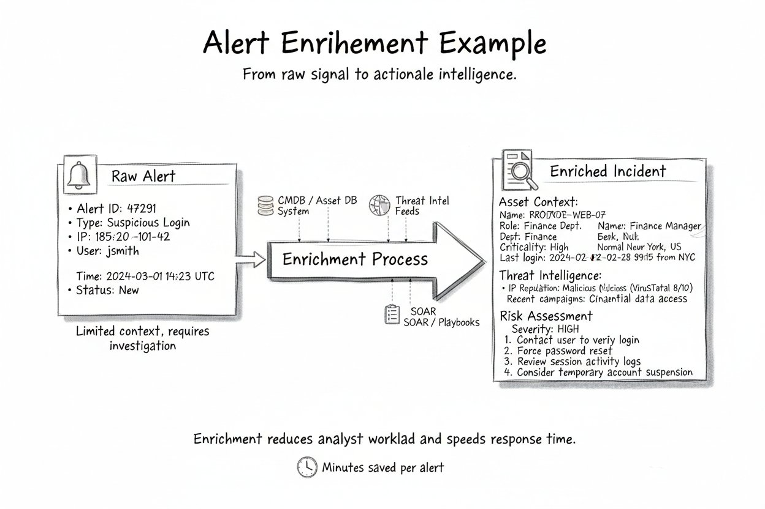
Principles of Effective Alert Design: Correlation and Grouping
Correlation and Grouping of Alerts
Correlating and grouping related alerts into unified incidents reduces the overwhelming noise analysts face and reveals coherent attack narratives. Individual alerts like failed logins or file downloads may seem minor alone, but together tell a story of credential compromise or data theft. Effective systems group alerts by common elements such as user, system, time window, or known kill chain stages. This transforms disconnected signals into a clear incident view, allowing analysts to investigate meaningfully rather than triaging isolated events. By focusing on coherent incidents instead of raw alerts, analysts can prioritize efforts, reduce alert fatigue, and respond more effectively to real threats.
Harnessing AI and Human Expertise: Advancing Cybersecurity in an Evolving Digital Landscape

Slide 22
Principles of Effective Alert Design: Automated Enrichment
IP Reputation
Asset Context
User Profile
Historical Context
Similar Incidents
Automated enrichment provides information about the reputation of involved IP addresses. Knowing if an IP is associated with known malicious infrastructure, such as command-and-control servers, helps analysts quickly assess threat severity without manual lookup.
Alerts are enriched with details about the affected systems, including their designation, assigned user or owner, department, and sensitivity level. This context enables analysts to understand potential business impact immediately.
Information about the user involved in the alert is included, such as their role, risk score based on behavior, and any prior security incidents. This helps determine whether the activity is anomalous or typical for that individual.
Analysts see whether the alerted activity is a first-time occurrence or part of a pattern. Knowing if similar events have been seen before guides decisions on urgency and investigation depth.
The system highlights if related suspicious activity has been observed across the organization or other entities recently. This broader perspective aids in identifying coordinated campaigns or emerging threats.
Harnessing AI and Human Expertise: Advancing Cybersecurity in an Evolving Digital Landscape

Slide 23
Principles of Effective Alert Design: Actionable Recommendations
Clear Next Steps
One-Click Responses
Escalation Paths
Playbook Links
Good alerts provide explicit guidance outlining recommended actions to take immediately. Analysts should understand what to do next without needing additional research or interpretation, enabling swift and confident responses.
Alerts should include convenient buttons or options that allow analysts to take actions such as isolating a system, disabling an account, or blocking an IP address directly from the alert interface, reducing response time and errors.
Effective alerts clearly define when and how to escalate an incident. Providing this guidance ensures that critical issues receive timely attention from appropriate stakeholders, maintaining control and accountability.
Alerts should connect analysts to relevant investigation procedures and playbooks. Providing direct links streamlines the workflow and ensures best practices are followed consistently.
Harnessing AI and Human Expertise: Advancing Cybersecurity in an Evolving Digital Landscape

Slide 24
Principles of Effective Alert Design: Explainable AI Decisions
Explainable Alerts
When AI generates an alert, analysts need more than a simple risk score or a vague message about an anomaly. Explainable alerts provide clear insights into why the alert was raised. This includes listing key contributing risk factors such as unusual access times, new privileged status, or matches to patterns seen in known attacks. Alongside these factors, confidence indicators show how reliable the alert is based on AI training data. Comparisons to baseline behaviors highlight deviations, helping analysts see context at a glance. Finally, including the detection method details demystifies the AI’s reasoning process. Such transparency builds trust, empowering analysts to evaluate AI outputs critically and make informed decisions rather than relying blindly on automated judgments.
Harnessing AI and Human Expertise: Advancing Cybersecurity in an Evolving Digital Landscape

Slide 25
Principles of Effective Alert Design: Continuous Calibration
False Positive Tracking
Monitor alerts that are consistently dismissed or marked as incorrect. Tracking false positives helps identify recurring noise, ensuring the alert system doesn’t overwhelm analysts and can focus on genuine threats. This stage connects to analyst feedback by providing data on alert quality.
Analyst Feedback Integration
Enable analysts to provide easy input on alert usefulness by marking alerts as helpful or noisy. Their real-time feedback supports fine-tuning alert thresholds and improving AI detection accuracy. Feedback guides threshold adjustment for better tuning.
Threshold Adjustment
Based on false positive tracking and analyst feedback, adjust alert sensitivity levels and scoring thresholds. This tuning balances reducing noise without missing true threats, ensuring alerts remain relevant and manageable. Adjustment leads to detection gap analysis.
Detection Gap Analysis
Review incidents that were missed by alerting to identify gaps in detection. Understanding what types of threats bypassed alerts informs further tuning and rule updates. This analysis ensures the system evolves to capture emerging or novel attack patterns.
System Evolution and Noise Clearing
The alert system continuously evolves by integrating tracking, feedback, adjustments, and gap analysis. It clears operational noise while enhancing detection capabilities, resulting in more precise, actionable alerts over time. This ongoing cycle returns to false positive tracking for continuous improvement.
Harnessing AI and Human Expertise: Advancing Cybersecurity in an Evolving Digital Landscape

Slide 26
Case Study: Alert Design Failure and Recovery
01
02
Initial Alert Overload
Improved Alert Design
During a major ransomware attack on a healthcare organization in 2023, AI detected 47 alerts linked to the attack chain over 72 hours. These alerts included unusual PowerShell commands, lateral movement, and reconnaissance activities. However, analysts were overwhelmed by over 12,000 total alerts that week and did not investigate any of these specific warnings. The alerts were uncorrelated, lacked context about system criticality, and provided risk scores without explanations, leading to missed detection despite AI capabilities.
Following the breach, the healthcare organization redesigned their alert system. They implemented alert correlation to group related incidents, added contextual business information through enrichment, prioritized alerts based on asset criticality, and provided explainable risk scores. As a result, six months later, the same AI platform enabled analysts to detect and contain a similar attack in under two hours, demonstrating the critical role of effective alert design and human-AI collaboration.
Harnessing AI and Human Expertise: Advancing Cybersecurity in an Evolving Digital Landscape

Slide 27
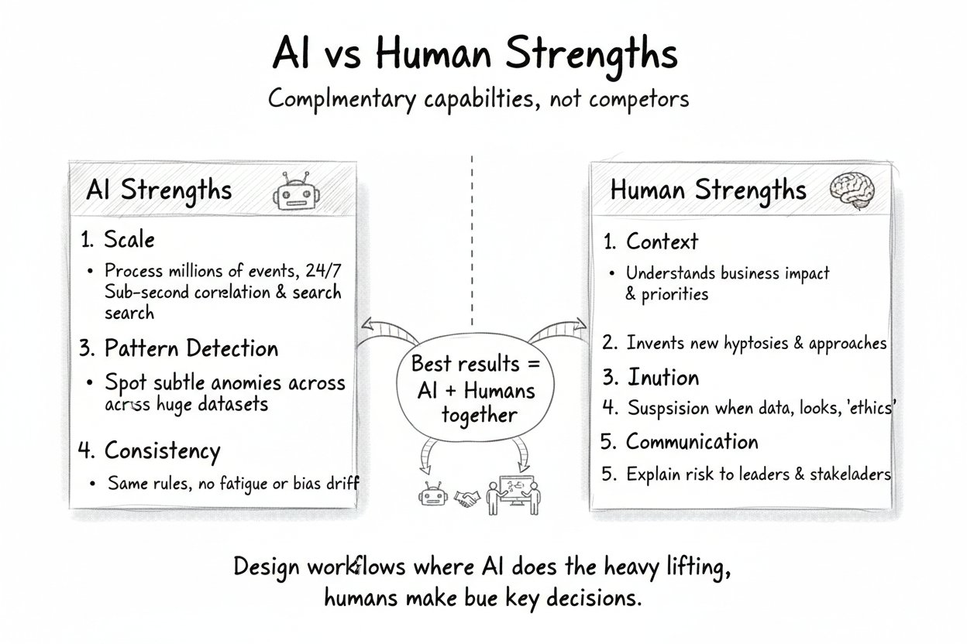
Building Trust Between Humans and Machines: Overview
01
02
03
Calibrated Trust
Dangers of Automation Bias
Risks of Automation Distrust
Effective human-AI collaboration in cybersecurity depends on calibrated trust, which means understanding AI's strengths and limitations well enough to rely on it appropriately. This form of trust avoids both blind acceptance and outright rejection of AI insights, enabling analysts to use AI where it excels and apply human judgment where necessary.
Automation bias occurs when people trust AI outputs too much, assuming they are correct without verification. This can cause analysts to defer to AI even when human judgment should override, potentially missing obvious errors or attacks that AI fails to detect.
Automation distrust happens when people trust AI too little, ignoring accurate AI recommendations and insisting on manual processes. This skepticism wastes AI investments and leaves analysts overwhelmed by alert volume, reducing overall security effectiveness.
Harnessing AI and Human Expertise: Advancing Cybersecurity in an Evolving Digital Landscape

Slide 28
The Trust Calibration Problem
Automation Bias
Automation Distrust
Consequences of Miscalibrated Trust
Need for Calibrated Trust
Analysts sometimes trust AI outputs too much, accepting recommendations without verification. This can lead to overlooking errors, false positives going unchallenged, and AI manipulation going undetected, ultimately causing critical threats to be missed.
Conversely, analysts may trust AI too little, ignoring accurate recommendations and insisting on manual processes. This underuse of AI leads to wasted investments and continued analyst overwhelm, reducing overall security effectiveness.
Both over-trusting and under-trusting AI result in operational risks. Over-trust may cause complacency and missed alerts; under-trust causes inefficiency and lost opportunities to leverage AI strengths, harming threat detection and response.
Effective human-AI collaboration requires calibrated trust, where users rely on AI where it excels while applying human judgment as needed. This balance avoids dangers of automation bias and distrust, ensuring reliable and efficient security operations.
Harnessing AI and Human Expertise: Advancing Cybersecurity in an Evolving Digital Landscape

Slide 29
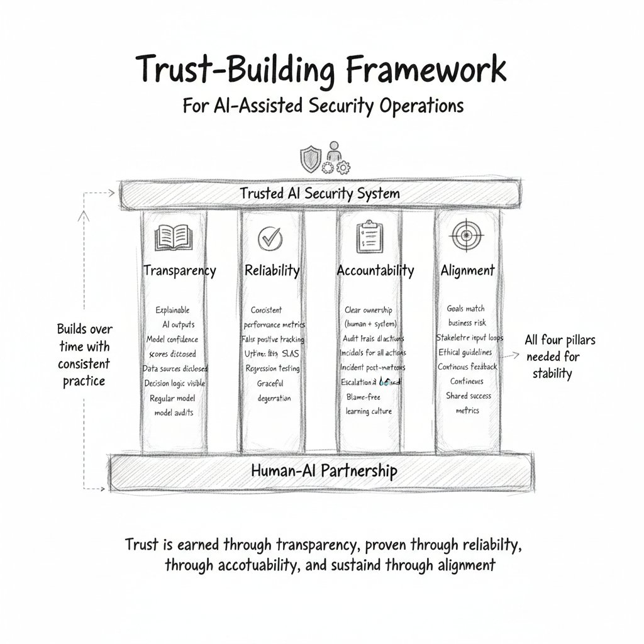
Building Trustworthy AI Systems
Transparency
Reliability
Transparency means clearly documenting what the AI can and cannot do, communicating honestly about accuracy including failures, and providing visibility into how decisions are made. This openness helps users understand AI behavior, fostering confidence by setting realistic expectations and revealing limitations.
Reliability ensures AI systems perform consistently over time with predictable behavior. It includes gracefully managing edge cases, offering clear confidence scores that correlate with actual accuracy, and maintaining stable outputs without unexpected changes, which builds user trust in AI dependability.
Accountability
Alignment
Accountability involves creating audit trails of all AI decisions, establishing human oversight for critical actions, defining responsibilities for AI-influenced outcomes, and regularly reviewing AI performance. This ensures there is a responsible party and supports ethical, legal, and operational transparency.
Alignment means AI objectives and recommendations match security team goals, consider business context, and conform to organizational risk tolerance and values. This ensures AI behavior supports the overall mission and priorities, strengthening trust through consistent, relevant outputs.
Harnessing AI and Human Expertise: Advancing Cybersecurity in an Evolving Digital Landscape

Slide 30
Helping Humans Trust Appropriately
01
02
03
04
Education
Gradual Exposure
Psychological Safety
Cultural Factors
Training analysts on how the AI works is essential, moving beyond black box perceptions to understandable principles. Clear guidance helps them know when to trust AI outputs and when to override them. Case studies of successes and failures along with hands-on experience foster practical understanding before high-stakes deployment.
Introducing AI as a recommendation engine at first helps build trust without overwhelming users. Autonomy can increase as analysts gain confidence based on demonstrated AI accuracy. Customization options allow analysts to adapt AI behavior to their workflows. Celebrating AI successes and learning collectively from failures reinforces collaboration.
Creating a culture where questioning AI is encouraged without fear of reprisal is vital. Analysts should feel safe to override AI when appropriate, recognizing these moments as learning opportunities. Avoid blaming either humans or AI exclusively to foster partnership rather than competition between them.
Building calibrated trust requires organizational commitment to transparency and open communication about AI capabilities and limitations. Encouraging collaboration and continuous learning helps analysts align trust with AI performance. A positive culture balances reliance on AI with critical human judgment for optimal decision making.
Harnessing AI and Human Expertise: Advancing Cybersecurity in an Evolving Digital Landscape

Slide 31
Trust Repair After Failures
Immediate Acknowledgment
When an AI system fails, organizations should promptly acknowledge the failure without hiding or minimizing the issue. Transparency about the problem is essential to maintain credibility and begin the trust restoration process.
Transparent Communication
Share findings openly with affected analysts and stakeholders. Clear and honest communication helps the team understand what went wrong and fosters a culture of trust and learning rather than blame.
Validation
Before restoring full autonomy to the AI system, demonstrate through evidence and testing that corrective actions have resolved the issues. Validating fixes reassures users and sustains confidence in AI assistance moving forward.
Root Cause Analysis
Investigate and understand why the AI failure occurred. This involves detailed examination of the system's behavior, data inputs, and contextual factors that contributed to the error. Identifying the root cause is critical to preventing similar issues in the future.
Corrective Action
Take concrete steps to fix the underlying problems discovered during analysis. This includes implementing improvements, updating AI models, adjusting processes, or enhancing human oversight measures to prevent recurrence.
Harnessing AI and Human Expertise: Advancing Cybersecurity in an Evolving Digital Landscape

Slide 32
The Mature Human-AI Partnership
The Mature Human-AI Partnership
In mature cybersecurity operations, human-AI collaboration is seamless and highly effective. Analysts trust AI for its strengths: processing large volumes of data, detecting complex patterns, maintaining consistency, and enriching alerts with useful context. This trust is not blind, but based on understanding the AI's capabilities and limitations.
Humans apply their judgment where it is most valuable: in ambiguous situations, high-stakes decisions, novel threat detection, and interpreting business context. They do not simply defer to AI, but actively engage with its insights, overriding recommendations when their expertise is superior.
AI continuously improves by learning from analyst feedback, adapting to changing environments, and expanding its capabilities. It does not stagnate after deployment but evolves alongside threats and defenses.
Meanwhile, human analysts develop new skills, focusing on higher-value work such as complex investigations, strategic threat hunting, and AI supervision. They become trainers and supervisors of AI systems rather than being replaced by them.
This partnership is not a final destination but an ongoing evolution where both humans and AI advance together, creating a stronger, more adaptive cybersecurity defense.
Harnessing AI and Human Expertise: Advancing Cybersecurity in an Evolving Digital Landscape

Slide 33
Measuring Human-AI Partnership Effectiveness
Detection Metrics
Efficiency Metrics
Measure how quickly threats are discovered and the breadth of coverage. Mean Time to Detect (MTTD) should decrease as AI enables faster threat surfacing. Detection coverage expands with AI monitoring diverse data sources. The discovery of novel threats improves as humans guide AI learning.
Evaluate how resources are optimized in security operations. False positive rates should decline through ongoing human feedback. Analyst focus shifts towards high-value work. The ratio of alerts requiring human intervention decreases, improving operational workflow.
Response Metrics
Partnership Health Metrics
Track the speed and effectiveness of reactions. Mean Time to Respond (MTTR) should decrease as AI accelerates triage processes. Containment effectiveness improves when humans apply context-aware decisions. Consistency of response increases with AI-supported playbooks guiding actions.
Assess the quality of collaboration between humans and AI. Measure analyst trust through surveys and observed behaviors. Track override rates to understand appropriateness of human decisions. Evaluate feedback quality to ensure effective translation of human insight into AI improvements.
Harnessing AI and Human Expertise: Advancing Cybersecurity in an Evolving Digital Landscape

Slide 34
The Detective Lens: AI-Driven Discovery Phase
AI-Driven Discovery Phase
During the discovery phase of investigations, AI excels at processing vast amounts of data quickly and efficiently. It can analyze months of logs within minutes to establish a precise timeline of events related to an incident. AI correlates events across multiple systems that the attacker has accessed, identifying related indicators of compromise that might otherwise go unnoticed. It also searches threat intelligence databases for similar attacks, allowing analysts to understand potential threat actors. By assembling this comprehensive evidence package rapidly, AI provides a foundation that would take human analysts days to build, enabling faster and more informed human interpretation and response.
Harnessing AI and Human Expertise: Advancing Cybersecurity in an Evolving Digital Landscape

Slide 35
The Detective Lens: Human Interpretation Phase
Human Interpretation Phase
After AI assembles the evidence, human analysts take on the critical role of interpretation. They analyze what the attack pattern reveals about the adversary's capability and intent, considering why specific systems or data were targeted. Analysts apply investigative intuition and organizational context to understand what defenses failed and what stealth tactics the attacker might have used. This phase involves strategic questioning that AI cannot perform, such as evaluating the sufficiency of evidence, deciding on further investigation, assessing confidence in threat attribution, determining appropriate remediation actions, and deciding who to inform within the organization or externally. Human insight transforms raw AI data into meaningful understanding necessary for effective response and risk management.
Harnessing AI and Human Expertise: Advancing Cybersecurity in an Evolving Digital Landscape

